Slide 1

AI-POWERED FALL DETECTION & EMERGENCY RESPONSE SYSTEM FOR ELDERLY CARE
Team Raksha

Slide 2
Details
Team : Raksha
Institution : Sridevi Women’s Engineering College
Team Size : 4
Domain : Artificial Intelligence

Slide 3
PROBLEM STATEMENT
  Elderly people are vulnerable to bathroom falls, especially when living alone.
  Falls may go unnoticed, causing delays in assistance.
  Existing wearables can be costly, uncomfortable, or easily forgotten.
  There is a need for an affordable, privacy-conscious, non-intrusive solution.
  The system should detect a possible fall, give the caregiver a short time to respond, and send an urgent alert if there is no response.

Slide 4
PROPOSED SOLUTION
“Raksha turns a silent bathroom emergency into an alert that someone can act on.”
Raksha uses the HLK-LD2410C with an ESP32 to monitor an elderly person inside the bathroom without using a camera.
Possible fall detected → Raksha triggers a 20-second verification window.
During this window, the system checks for recovery or continued inactivity.
No recovery detected → An urgent Telegram alert is automatically sent to the caregiver.
Caregiver receives the alert and can immediately check on the elderly person.

Slide 5
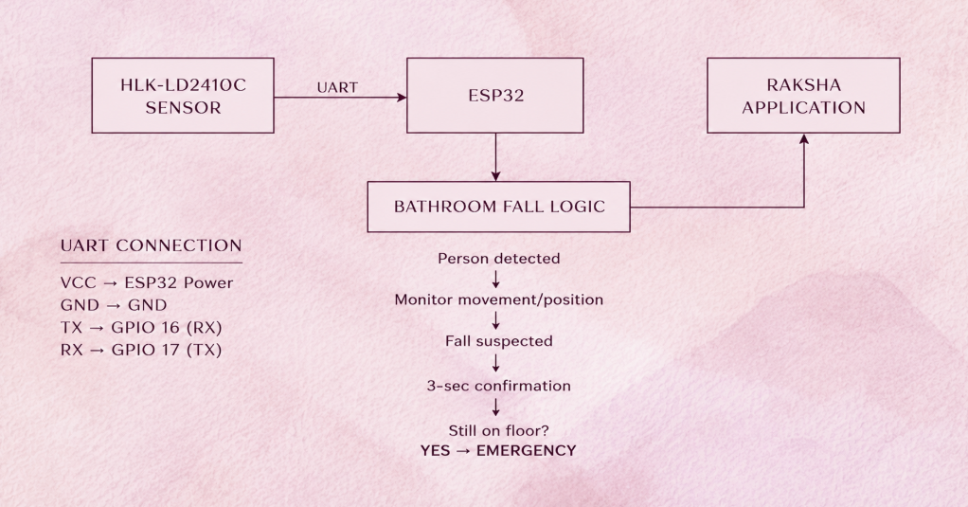

Slide 6
FLOWCHART
HLK-LD2410C
↓
ESP32
↓
Fall Detection
↓
Raksha App
↓
Caregiver Alert
↓
20-sec Response
↓
Resolved / Telegram Alert

Slide 7




TECHNOLOGY
Python
OpenCV
MediaPipe
Streamlit
SMS/
Notification API
Future IoT integration

Slide 8
INDIA–JAPAN: BUILDING THE FUTURE OF ELDERLY CARE TOGETHER
INDIA
  Affordable elderly monitoring for homes and communities where full-time caregivers aren't always possible.
  A low-cost solution that works with devices families already have.
JAPAN
  Fits directly into Japan's super-aged society challenge — one of the most urgent in the world.
  Built to complement Japan's world-leading elder-care robotics and smart-home technology.
"An affordable AI-based bridge between Indian and Japanese approaches to elderly care."

Slide 9
FUTURE SCOPE
  Wearables + IoT → combine camera and sensor data.
  Smart Homes → automatic emergency response.
  Elder-care Robotics → connect fall detection with assistive robots.
  Advanced AI → improve detection and reduce false alarms.
Today: AI Fall Detection.
Tomorrow: AI + IoT + Smart Home + Elder-Care Robotics.

